Slide 1
Contemporary Models in Fish Population DynamicsAnd Their Application to Fisheries Management
Jornades de Modelamiento Matematico
y Gestión Pescados (M²GP)
Valparaiso, Chile
January 2016
Terrance J. Quinn II
School of Fisheries and Ocean Sciences
University of Alaska Fairbanks
Juneau Alaska USA
Terry.Quinn@alaska.edu

Slide 2
The Wonderful World of Fish Population Dynamics
Biology
Birth, Death, Sex (Reproduction)
Mathematics
  Change, Differential Equations, Difference Equations
Statistics
Uncertainty, Stochasticity, Error, Risk
Socio-economics
Fisheries, Income, Employment, Communities

Slide 3
Point of View
Predictament of mathematical modelers of fish and fisheries (AKA fisheries stock assessment scientists, fish population dynamicists)
Observations and models: the two sides
Which is real life?
People: It’s observations!
Modelers: It’s the models!

Slide 4
Uncertainty: Types of “error”
Measurement and sampling error
Process (parameter) error: e.g., variability over time
Model error (mis-specification)
Management (implementation error)

Slide 5
Understanding Fish
Assessment (Accounting, Estimation) WHAT?
Forecasting (Prediction, What If? scenarios) HOW?
Cause and Effect (Understanding the processes ⇒ Experiments, Process studies) WHY?

Slide 6
Differences from Human Demography
Sampling, not censusing
Not representative of population
Missing data: gaps, age- or size- and/or gear- selective
Observation, process, AND model mis-specification errors
Must be jack of all disciplines (mathematics, statistics, biology, environment/ocean, computation, socio-economics, politics)

Slide 7
Simple Historical Models
Exponential, Geometric (Malthus)
  dN/dt = r N ⇒ N(t) = N₀ exp(rt)
Logistic (Malthus)
  Still basis for theory of fishing, sustainability
  dN/dt = r N (1 – N/K), K = carrying capacity
  Compensation, density-dependence
Features: No (age) structure, no biological lags
Gompertz: rarely used

Slide 8
Modeling: Dynamics
Connects data and population dynamics
New abundance = Previous abundance
– Fishing deaths
– Natural deaths
+ Recruitment
+ Immigration – Emigration
Recruitment
  Related to previous spawning stock
  Related to previous environmental conditions
  Related to other species

Slide 9
Modeling: Basic Equations
Total Mortality Z = Fishing Mortality F + Natural Mortality M
Survival S = exp(−Z)
Abundance N_{y+1} = N_{y} S_{y} (year y)
Separability equation F_{a,y} = s_{a} F_{y} (age a)
Catchability equation CPUE_{y} = (s*_{a} Q) N_{y}
Thus observed quantities are not directly representative of the population.

Slide 10
The Holy Grail: Age-structured Analysis

Slide 11
Prototype of Underlying Dynamics
10 ages
M: U-shaped
F: logistic (50% selectivity at age 3)
L: von Bertalanffy
W: isometric

Slide 12
Prototype (continued)
Maturity: logistic (50% mature at age 5)
Fecundity: isometric
Spawner-recruit relationship: Ricker

Slide 13
Sustainability
No matter whether the population starts low or high, it equilibrates to stable age distribution.

Slide 14
Estimation Goals
Abundance (#), Biomass (t)
Mortality and Survival
Growth: Length, weight
Reproduction: Maturity, reproduction, recruitment
Fishing parameters: Selectivity, Catchability
Movement/ Migration

Slide 15
Modern Stock Assessment
Data Collection
  Fishery
  Surveys
Modeling and analysis
  Population dynamics
  Uncertainty in measurement and in process
  Factors affecting the population (environment, covariates)
Management recommendations

Slide 16
Data from the Fishery
Total catch and harvest
Composition: length, age, sex
  Follow year-classes through time
Catch-per-unit-effort CPUE
  Needs validation for relation to abundance

Slide 17
Data from the Survey(s)
Abundance estimation
Growth
Movement (tagging)
Maturity and fecundity (egg production)

Slide 18
Fishery Models (sensu K. Pollock)
VPA, Cohort Analysis, Catch-Age Analysis (Fry, Gulland, Pope, Doubleday, Fournier, Deriso&Quinn)
(Integrated) Age-structured Assessment (ASA) Models
Stock Synthesis Models
(Leslie) Matrix-type Models
Models of Fish Population Dynamics

Slide 19
Estimation: Objective Function
The objective function is used in stock assessment models to estimate parameters.
INTEGRATED ASSESSMENT
A general equation for the objective function is:
Here, G is some function that relates the data, D, to the model predictions, P, for dataset x; λ is the weighting term.

Slide 20
Estimation: Statistical distributions
Objective function G operates essentially as the likelihood to connect the data to the model parameters and equations. For example:
Abundance data: Usually lognormal, so that weighting term λ ≈ 1/CV².
Age composition: Usually multinomial or Dirichlet, so that λ ≈ sample size n.
Parameters: “Quasi-Bayes” (normal-esque), in the form (parameter – prior)² / (Prior Variance)

Slide 21
Documentation, Software
Quinn and Deriso. 1999. Quantitative Fish Dynamics, Oxford.
Books by Hilborn and Walters, Getz, Caswell, Haddon
Journals: CJFAS; ICES J Mar Sci; Fish Res; Nat Resource Modeling
Software must be able to handle up to hundreds of parameters, thousands of observations.
Historical: Excel, local products, still used

Slide 22
AD Model Builder (ADMB)
Creator: Dave Fournier
Automatic differentiation (Hessian)
Open source http://admb-project.org/
Interface with R (simulations)
Generic objective functions, including robust likelihood
Ability to do bootstrapping
MCMC for likelihood or Bayesian models

Slide 23
Modeling the Way to Reality
How do mathematical modelers make such a simple construct more realistic to deal with environmental variability, climate change, stock structure, migratory events?
We always find a way, imperfect as it may appear.

Slide 24
Variation 1: Stochasticity
Start with deterministic Ricker spawner-recruit relationship
Add stochastic effects for temporal change, environment
Lognormal variability, E(R)= deterministic
CV σ is usually HIGH (> 0.5).

Slide 25
Stochastic principles
Stochastic effects are large on all population parameters, but sustainability is still expected.
These effects occur at all life stages.
The effect is downward: yield, population abundance, and egg production are lower than the deterministic case.
Regenerative ability is poorly estimated.
Other approaches: Bayesian hierarchical models, meta-analyses, Kalman filtering, random effects models

Slide 26
Variation 2: Time-varying population parameters
Natural mortality: U-shaped distribution not well determined
A function of predators and disease?
  Approach 1. Covariates (disease prevalence, predator abundance)
  Approach 2: Random, correlated, or ARIMA “walks”
  Approach 3. Study early life history.

Slide 27
Variation 2, continued
  Multi-species models (include stomach contents data)
Deconstruct Z into:
  Fishing mortality F
  Predation or disease mortality P
  Residual natural mortality M
The multispecies model is simply an extension of the single species model, in which Z = F + M + P.

Slide 28
Effective number of parameters
The number of true effective parameters in the model, as in degrees of freedom issues
With random or autocorrelated walks for time-varying parameters
Deviance Information Criterion (DIC) for model selection

Slide 29
Variation 3: Multiple datasets
Data weighting issues
  Reevaluate objective function G?
  What to do about weightings {λ_{i}}?
    Pre-specify and do sensitivity study.
    Estimate them: iterative reweighting.
    Use effective sample size or priors. Theory is not definitive.
Data conflicts – Exposed but not resolved!
Model selection: AIC, BIC, DIC, WIC instead of LR tests

Slide 30
Effective sample size
The effective sample size used as the data weighting would be smaller than the sample size due to:
  Ageing error
  Number of tows sampled in survey/fishery
  Number of vessels sampled
  Age aggregation of fish within schools

Slide 31
Variation 4: Extensions for realism
Spatial models (movement)
Seasonal models (multiple fisheries)
Size-structured models (when ageing isn’t possible or accurate)
Genetic models (stock structure)
Stochastic delay - differential equation models (because many biological processes are really continuous)

Slide 32
Population structure (Goethel et al. 2011)
1. Single population (with spatial heterogeneity)
2. Overlapping populations with natal homing
3. Subpopulations with reproductive mixing

Slide 33
Mathematical Modeling and Fisheries Management
Mathematical modeling produces fisheries stock assessments.
Stock assessments are used for scientific management advice.
Scientific advice gets used to set limits on overfishing (now MSY or its proxies) and targets (acceptable biological catches, ABCs, and total allowable catches, TACs, to be achieved.
Scientists set ABCs; managers set TACs, such that TAC ≤ ABC (Magnuson-Stevens Act, U.S. Law)

Slide 34
Case study
Alaska groundfish and shellfish fisheries
Region: North Pacific Fishery Management Council (1 of 7 in the U.S.)
Process started in 1976 (40 years now)
Evolutionary and adaptive
Institutional memory
The Council has practiced science-based management , listening to its Statistical and Scientific Committee and Plan Teams.

Slide 35
The Fish
Walleye pollock
Pacific cod
Sablefish (Black cod)
Pacific halibut
Rockfish (several species, Sebastes)
Other flatfish
Other species (Skates, sculpins, squid, sharks, forage fish, corals, sea lions, whales, etc.): ECOSYSTEM

Slide 36
The Fisheries
Trawl
Longline
Pot
Groundfish
Crab
Scallops, Salmon
Pacific halibut (allocation, biology by IPHC)

Slide 37
Management
US Dept. of Commerce/ NOAA/ NMFS
North Pacific Fishery Management Council
Alaska, Washington, Oregon (Alaska majority)
Advisory Panel (industry)
Scientific and Statistical Committee
Plan teams (Groundfish, Crab, Scallops)
Assessment scientists (AFSC, ADF&G)

Slide 38
Process
5 meetings per year
All three committees meet at same place.
Public process for all three committees.
Scientists determine maximum catch levels.
Comprehensive observer program to collect catch and discard information; paid for by industry
Evolutionary process on annual or biannual basis.

Slide 39
Outline
Groundfish FMPs
*Determined Stocks in the fisheries
*Tier system for ACLs & evaluation of uncertainty
BSAI Crab FMP
*Established ABC using P* and buffers.
Scallop FMP
*Determined Stocks in the fisheries
*Established ABC using set buffer.
Salmon FMP
Reviewing FMP language to determine compliance with NS1 guidelines;
Arctic FMP
Status quo; new FMP developed w/NS1 guidelines.

Slide 40
Classification of Groundfish Stocks
In the Fishery (ACLs set)
Targets: pollock, cod, sablefish, mackerel, etc.
Vulnerable non-targets: shark complex, skate complex, sculpin complex, octopus, squid
Ecosystem Components
(no ACL set)
Forage Fish: smelt, capelin, euphausiids, etc.
Prohibited Species: crabs, salmon, halibut, herring
Not in the FMP
Non-specified species: grenadiers, barnacles, anemones, etc.

Slide 41
Groundfish Annual Catch Limits
In the North Pacific, annual catch limits are specified where:
TAC<ABC<OFL
OFL (overfishing level) is harvest limit associated with MSY.
ABC (acceptable biological catch) is the harvest limit that takes into account scientific uncertainty.
TAC (total allowable catch) is the target that includes socioeconomic considerations.
Acceptable Biological Catch (ABC)
Total Allowable Catch (TAC)
The SSC sets the OFL and ABC.

Slide 42
Groundfish Control Rules for OFL and maxABC
based on data available
Tier System Based of Quality of Data
Tier 1 -- Reliable B, B_{msy}, pdf of F_{msy}
Tier 2 -- Reliable B, B_{msy}, F_{msy}, F_{35%}, F_{40%}
Tier 3 – Reliable B, B₄₀, F_{35%}, F_{40%}
Tier 4 – Reliable B, F_{35%}, F_{40%}
Tier 5 -- Reliable B and M
Tier 6 – Reliable Catch History Data

Slide 43
Does the Tier system adequately address
scientific uncertainty in setting ABC?
AFSC analysis of current tier levels using P* (as well as a decision-theoretic approach).
P* analysis used 3 yr average CV of trawl survey biomass as proxy for OFL uncertainty.
Values of P* required to match existing OFL-ABC buffers calculated: average P*=0.12.
Average buffer sizes were:
  Tier 1 ~ 8%
  Tier 3 ~ 17%
  Tiers 5, = 25%
AFSC 2009. Setting Annual Catch Limits (ACLs) for BSAI and GOA Groundfish. Paper presented to the Groundfish Plan Teams. September 2009. 55 p.
ftp://ftp.afsc.noaa.gov/afsc/public/Plan_Team/ACL_Aug_2009.pdf

Slide 44
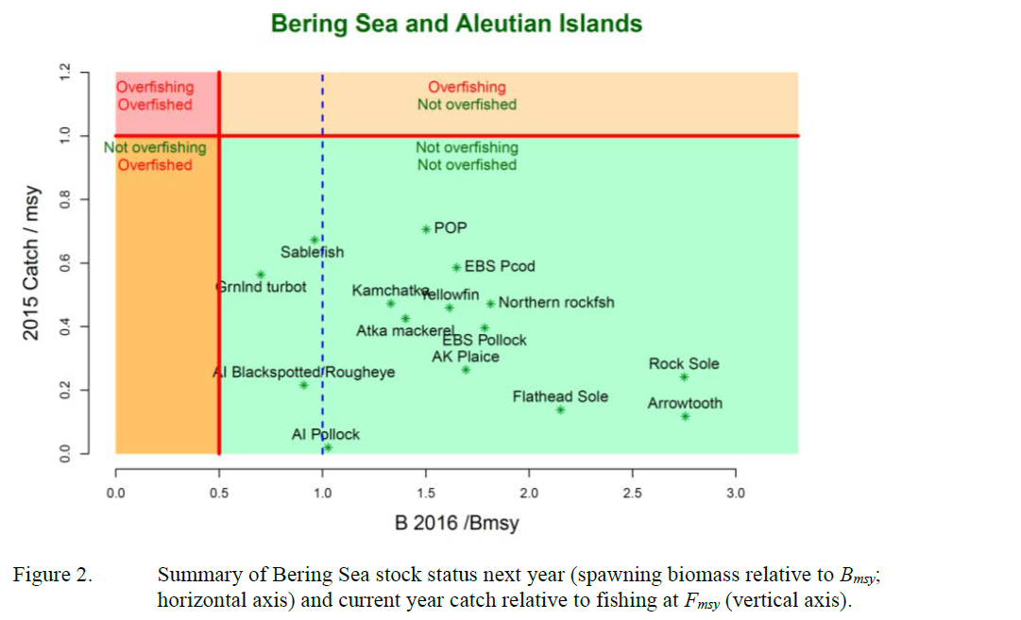
Report Card

Slide 45
Final thoughts
Scientific advice is critical for successful fisheries management.
Mathematical modeling is central in providing scientific advice.
Fish stocks have a remarkable ability to prosper and/or recover if we let them: In the U.S., overfishing has practically been eliminated, and there has been dramatic recovery of depleted fish stocks.
Fisheries science and management must be evolutionary, adaptive, and public to be successful.

Slide 46

Questions?

